Slide 1
Lung Transplant Education
Santa Barbara Cottage Hospital Cystic Fibrosis Program

Slide 2
WHY YOU ARE BEING REFERRED
Lung transplant will improve your quality and prolongation of life
Clinical Indications
Frequent pulmonary exacerbations (worsening of respiratory symptoms)
Rapid rate of decline in lung function
Supplemental oxygen requirement with exercise or sleep
Worsening malnutrition despite supplementation
Massive hemoptysis (coughing up blood) requiring intensive care unit admission
Recurrent pneumothorax (collapsed lung)

Slide 3
SELECTING A TRANSPLANT CENTER
MD will discuss options with you
UCSF – University of California San Francisco
UCLA – University of California Los Angeles
Stanford
USC – University of Southern California
Cedars Sinai
You can visit centers to see where you feel most comfortable
Geography and insurance may play a role
Scientific registry of transplant recipients: https://www.srtr.org
This site has lung transplant outcomes at different lung transplant centers

Slide 4
TRANSPLANT EDUCATION
HTTPS://UNOS.ORG
Visit website for transplant information and additional educational materials.
Brochures
Cost information
Prescription assistance
Pre and post transplant teaching material
More information on each transplant center:
https://lungtransplanteducation.ucsf.edu/
https://www.uclahealth.org/transplants/lung
https://www.cedars-sinai.org/programs/transplant-center/programs/lung.html
https://med.stanford.edu/cepb/clinical-care/clinical-programs/individual-clnical-program-page21.html
https://www.keckmedicine.org/centers-and-programs/lung-transplant/

Slide 5
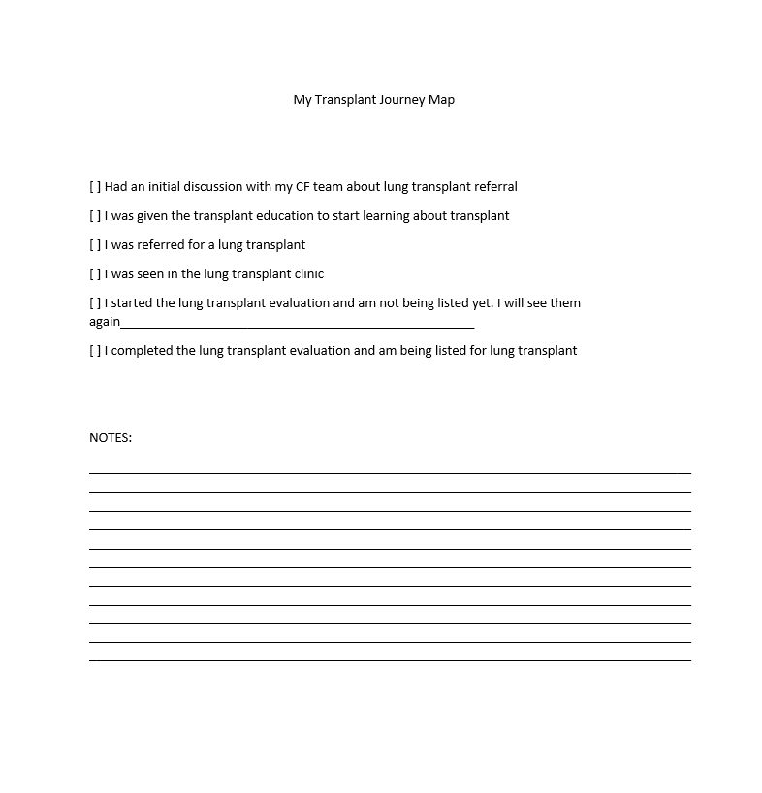
PREPARING FOR REFERRAL
Patient and family decisions
Where to go for transplant?
Who will provide support?
What to do about work?
Move to the transplant center?
Prepare friends and family
Transplant journey map

Slide 6
FINANCIAL ISSUES
Must have insurance coverage
Ability to travel to and from the transplant center every few months
Funds for support, travel, hotels, etc.
Some centers require that you move there
Can get help from social work, fund raising programs, and grants
Insurance approval does not necessarily cover all expenses. (Still need to pay for travel, hotel, etc.)

Slide 7
FINANCIAL ISSUES CONT’D
Fundraising
CF Team can help with ideas
Sansum Clinic has a CF reimbursement form that makes it possible for CF patients to be reimbursed for costs outside of traditional insurance (Helps cover gas, lodging, and meals)
Get more information at: 805-681-7726

Slide 8
Process for transplant referral
CF center sends information and test results to transplant center
Transplant center reviews the information
Transplant center checks insurance
Transplant center schedules appointment and calls patient
Transplant center may want more testing or information
Transplant Check list
Initial discussion and education provided
Referral sent to transplant center
Insurance authorization obtained
Appropriate testing/labs done for evaluation
Evaluation completed and patient accepted
Evaluation completed and patient deferred/on hold
Referral sent to another transplant center if denied
Patient listed for transplant
Patient transplanted

Slide 9
PRE-TRANSPLANT TESTING AND INFO
Bare Minimum
Clinic and hospital records
CT chest
PFTs
Sputum cultures
Echocardiogram
Demographic information-top
Labs
Also Important
V-Q scan
DEXA
Heart catheterization
Cancer screenings-colonoscopy
Dental evaluation
Vaccines

Slide 10
TYPE OF TESTING DURING EVALUATION (UCSF)
Testing that can be done locally
Bone density scan
PPD (skin test for TB)
Vaccinations
Hep A, Hep B, Tetanus, PNA, Flu, Covid, Varicella Zoster
PAP smear (women)
Mammogram (women)
Colonoscopy ( > 50 years)
Dental screening/clearance
Testing that has to be done at transplant center
Blood tests
PFTs
6 minute walk test
CT scan
EKG
Echocardiogram
Cardiac Catheterization
Abdominal Ultrasound
Urinalysis
24 hour urine testing
24 hours pH/manometry

Slide 11
FIRST VISIT TO TRANSPLANT CENTER
Orientation to transplant
Meet the transplant team
They will review your medical information and more testing may be needed
Transplant team will answer all questions from patients and families
Plan for the visit to take several days
See a variety of specialists that may be necessary:
Infectious disease, ENT, GI or liver, Psych, SW, Addiction services, and Endocrine

Slide 12
REFERRALS AND LISTING
Being referred and being listed are not the same thing
Transplant center needs to see and get to know you before they list you
Expect more testing before being listed
Listing based on LAS (Lung Allocation Score) – a score to estimate survival.
Once listed, may go on and off the active list.

Slide 13
WHAT WILL DELAY OR PREVENT YOU FROM TRANSPLANT?
Organisms like B cepacia
Non-adherence w treatments or keeping clinic appointments
Underweight or overweight
Active substance abuse-drug, alcohol, tobacco, opioids, etc. – Addressed in detail with the transplant team.
Lack of social support
Insurance coverage
You may be reconsidered when issues are resolved

